Slide 1

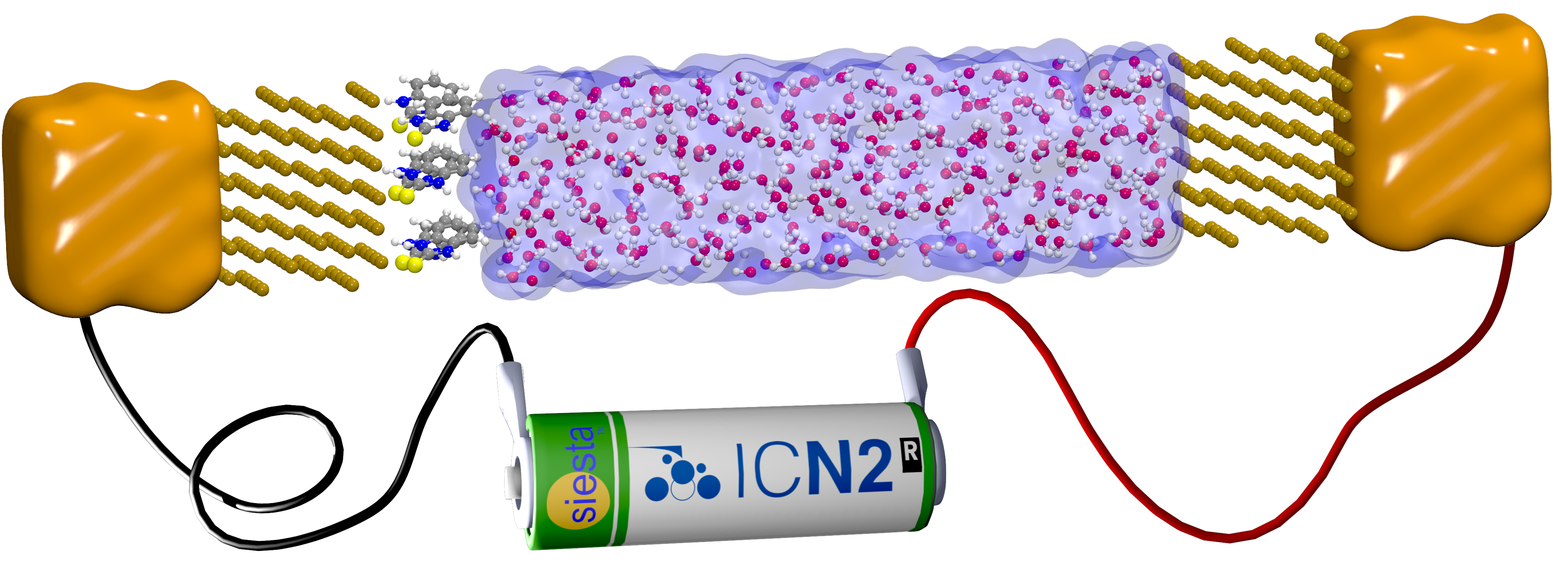

June 2nd, 2025
Electrochemical properties using TranSIESTA and QM/MM
Ernane de Freitas Martins
Group leaders:
Pablo Ordejón
Ivan Cole
Alberto García
PhD students:
José María Castillo (defended)
Mazhar Iqbal
Pol Febrer
(defended)
Postdocs:
Federico Pedron
ernane.defreitas@icn2.cat

Slide 2

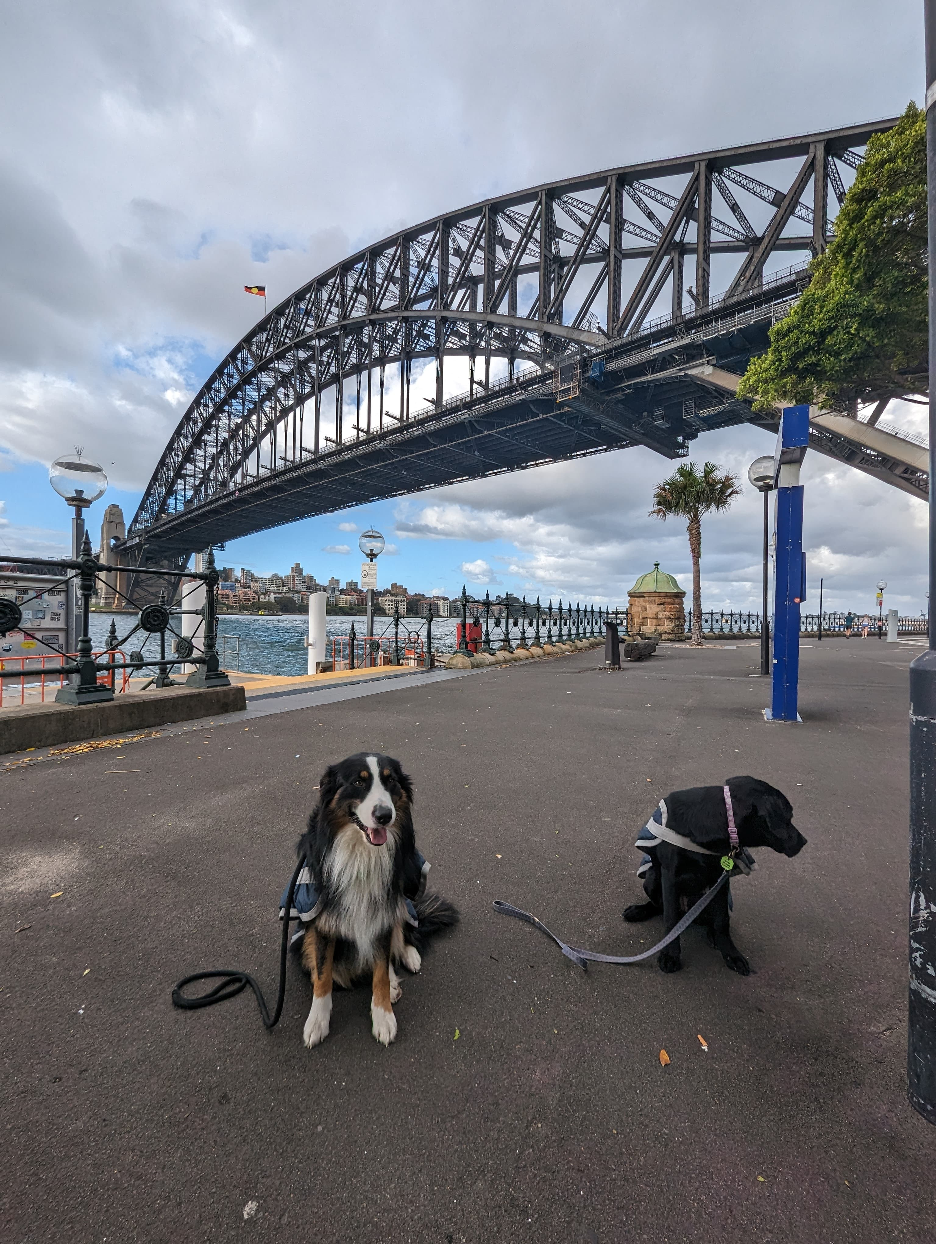

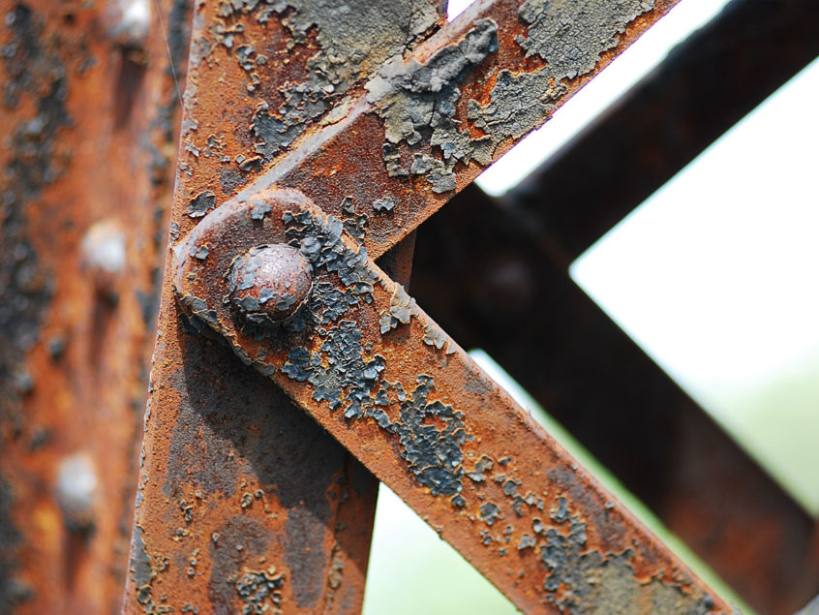

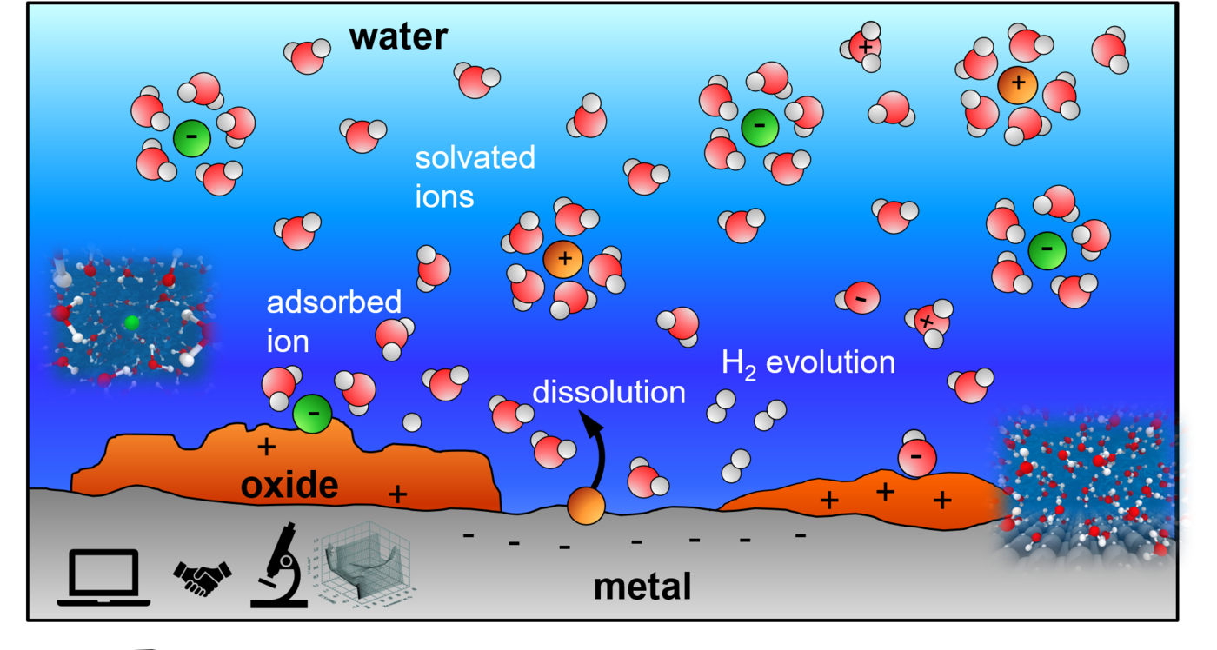
Why studying electrochemistry?
The corrosion problem
Thanks to José María Castillo
cm
Corrosion inhibition mechanism
is not well understood
nm
© Mira Todorova, Max-Plank-Institute für Eisenforschung GMBH
Electrochemical properties using TranSIESTA and QM/MM
Ernane de Freitas Martins
2

Slide 3
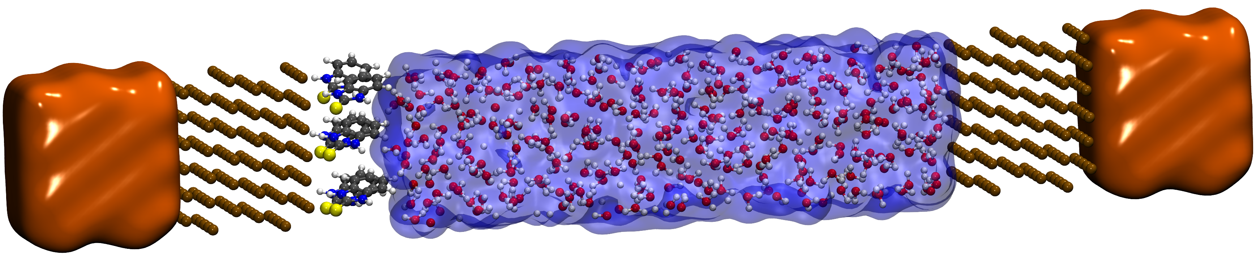
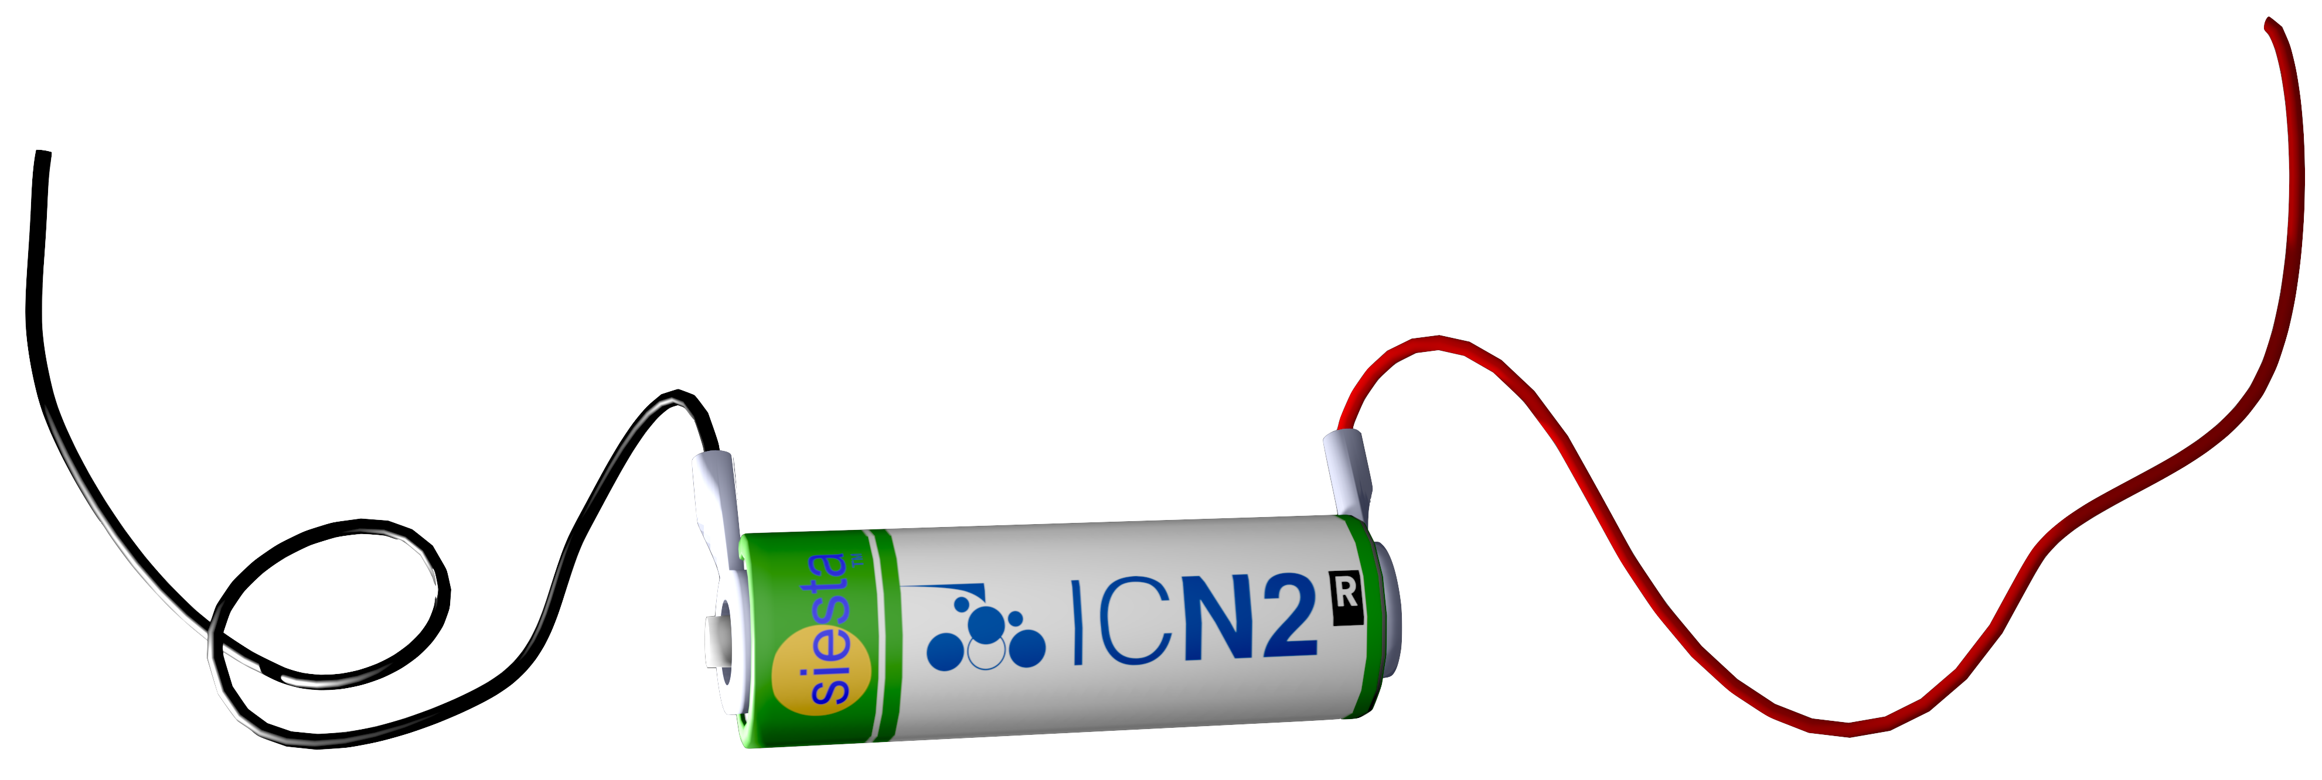
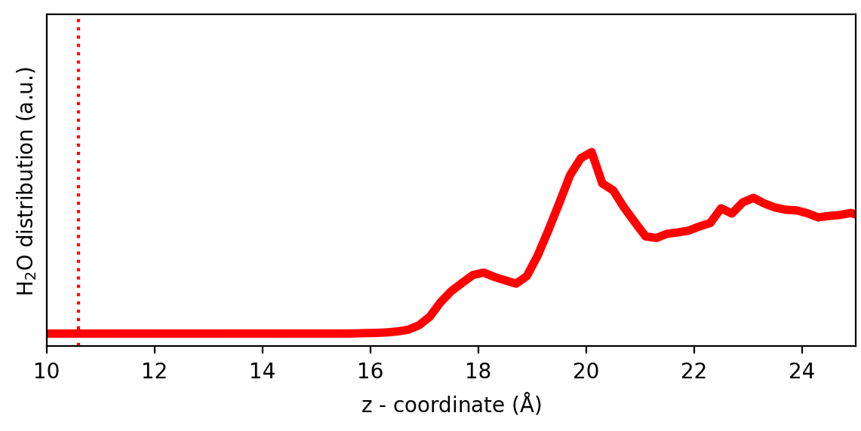




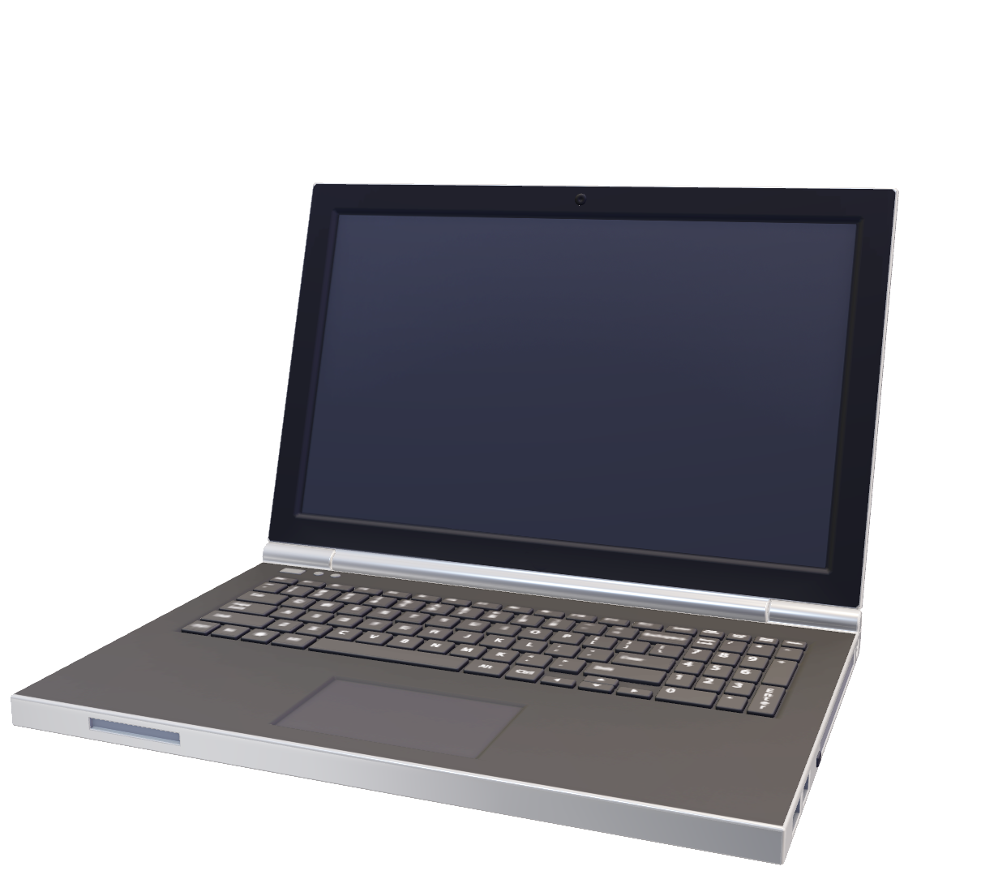

The final model desired
Beyond standard DFT for realistic systems: voltage and solvent
Water density
Solvent
Dynamics
Voltage
Electrified interface modelling
Electrochemical properties using TranSIESTA and QM/MM
Ernane de Freitas Martins
3

Slide 4
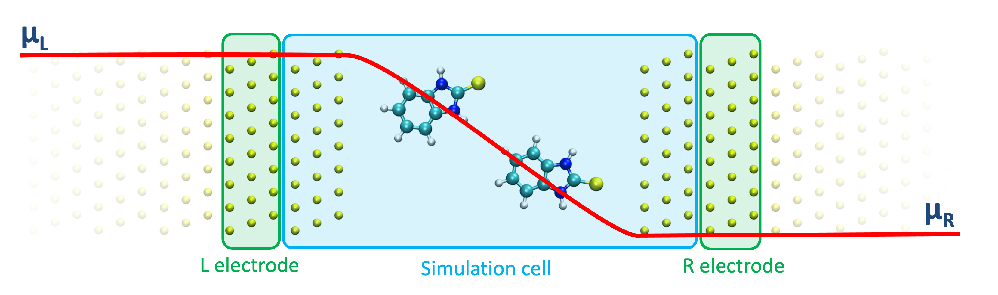
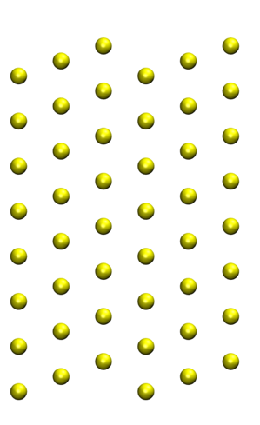
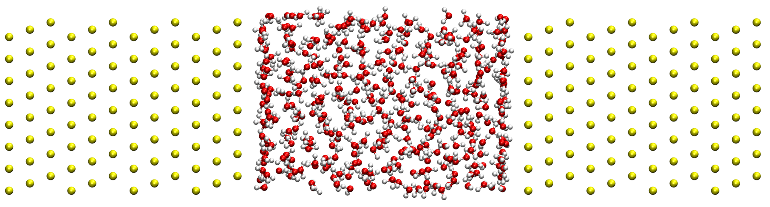
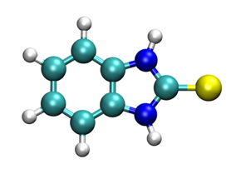


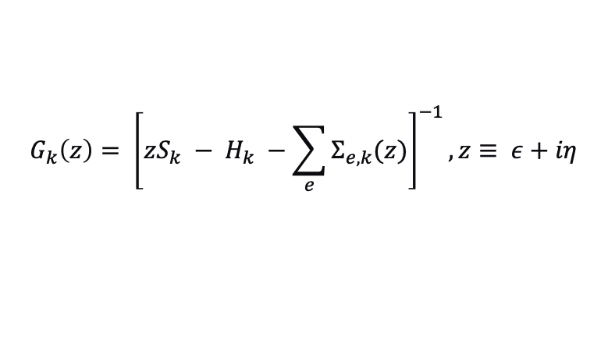
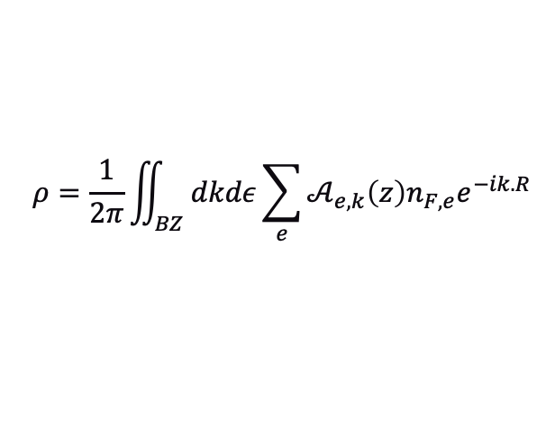

How is voltage included?
The non-equilibrium Green's functions formalism (NEGF) | TranSIESTA
Typical systems
µ_{L}
Spectral function
$$𝒜_{e,k}\left(z\right)=G_{k}\left(z\right)Γ_{e,k}\left(z\right)G_{k}^{†}$$
Broadening
$$Γ_{e,k}\left(z\right)=i\left[Σ_{e,k}\left(z\right)− Σ_{e,k}^{†}(z)\right]$$
µ_{R}
Green’s function
Density matrix
L electrode
Simulation cell
R electrode
$$G_{k}\left(z\right)= {\left[zS_{k} − H_{k} −\sum_{e}{Σ_{e,k}(z)}\right]}^{−1}, z≡ ε+iη$$
$$ρ=\frac{1}{2π}\iint_{BZ}{dkdε\sum_{e}{𝒜_{e,k}\left(z\right)n_{F,e}e^{−ik.R}}}$$
Brandbyge et al., Phys. Rev. B 65, 165401 (2002)
﻿Alberto García, et al., J. Chem. Phys. 152, 204108 (2020)
﻿Papior et al., ﻿Computer Physics Communications, 212, 8–24 Contents (2017)
Electrochemical properties using TranSIESTA and QM/MM
Ernane de Freitas Martins
4

Slide 5
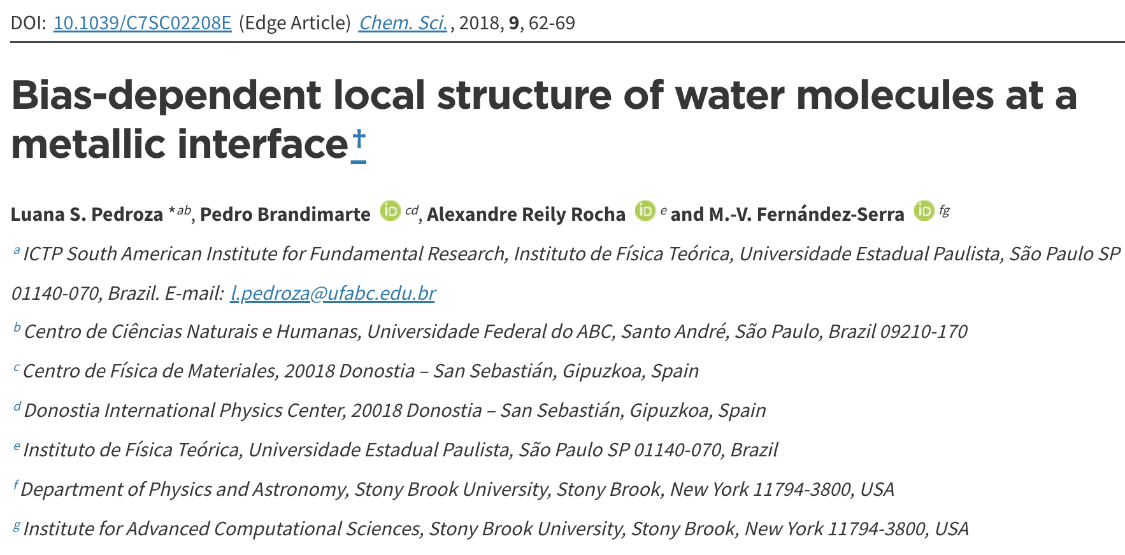
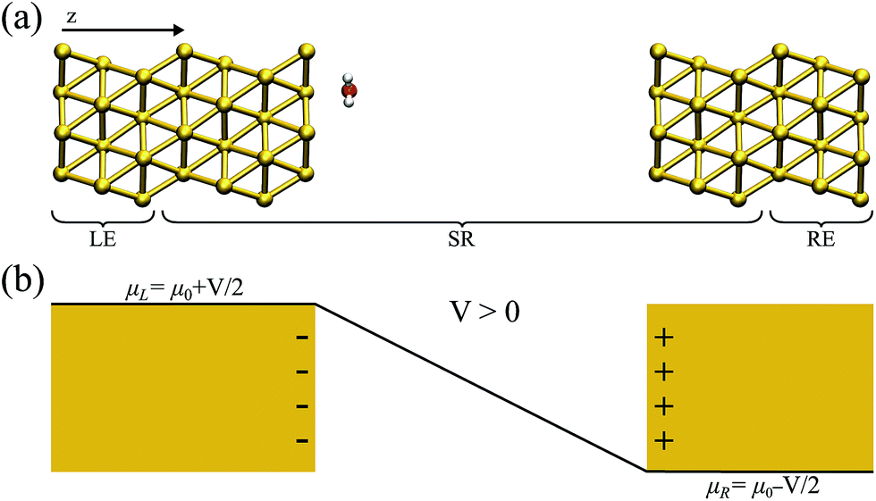
TranSIESTA in electrochemistry
Single water molecule in contact with gold electrodes
First time reported in electrochemistry | 2018
Pedroza et al., ﻿Chem. Sci., 212, 9, 62–69 (2018)
Electrochemical properties using TranSIESTA and QM/MM
Ernane de Freitas Martins
5

Slide 6
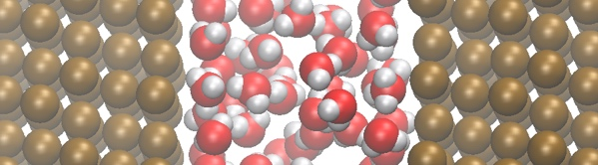
TranSIESTA in electrochemistry
Liquid water molecule in contact with gold electrodes
First time reported for liquid water | 2021
V = 0 V
V = -2 V
Slightly more pronounced layering induced by the bias.
Reorientation of water molecules:
H towards the negative electrode.
O towards the positive electrode.
1
𝛥V
-1
﻿Ordejón, P.; Febrer, P.; Bulletin APS (2021)
Electrochemical properties using TranSIESTA and QM/MM
Ernane de Freitas Martins
6

Slide 7
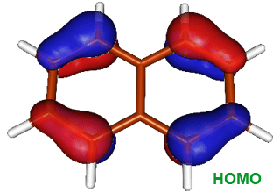
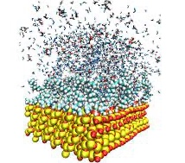
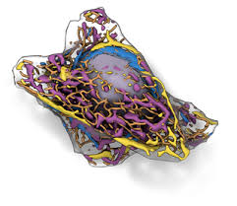
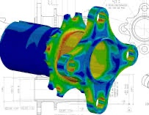
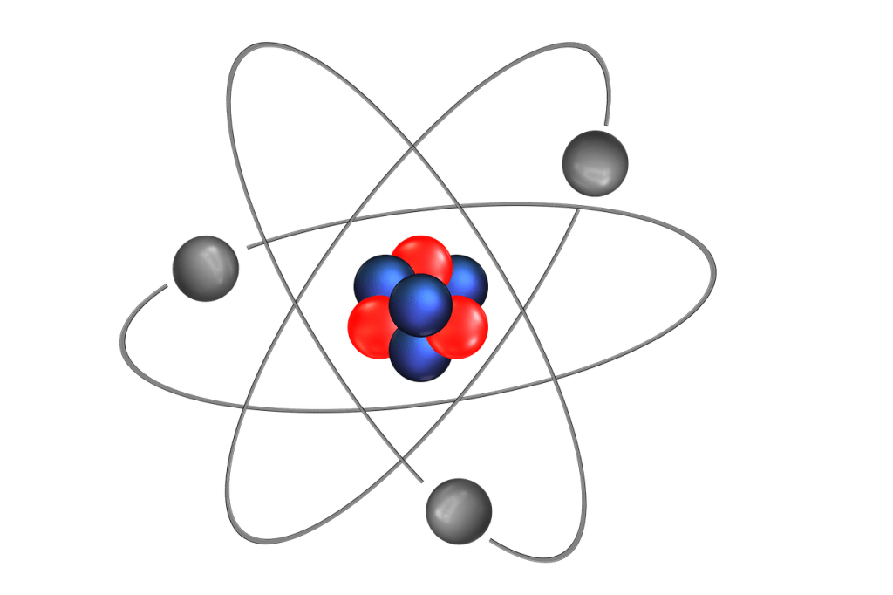
How to accelerate modeling?
Different scales of simulations
Thanks to Dr. Gabriela Dias
QM
MM
TIME
fs-ps
ns-μs
μs-ms
s
Quantum Mechanics
(DFT)
Molecular Mechanics
(classical MD)
Mesoscopic simulations
(Monte Carlo)
Continuum simulations
(PDE)
LENGTH
Å
nm-μm
μm-mm
mm-m
Electrochemical properties using TranSIESTA and QM/MM
Ernane de Freitas Martins
7

Slide 8
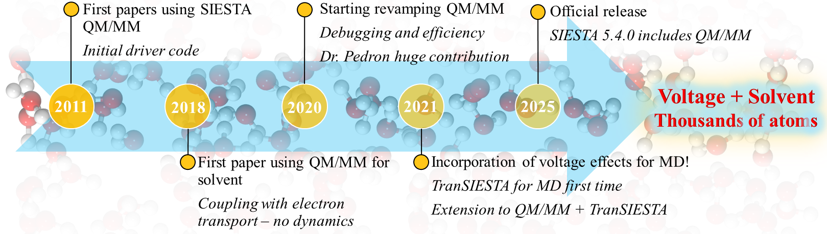
Details about the implementation
The method in SIESTA | timeline
QM
MM
﻿Crespo et al., J. Phys. Chem. B, 107, 13728-13736 (2003)
Sanz-Navarro et al., Theor. Chem. Acc., 128:825-833 (2011)
Prasongkit et al., J. Phys. Chem. C, 122, 7094-7099 (2018)
Martins et al., Molecules, 24(5), 7094-7099 (2019)
Martins et al., Carbon, 158, 314-319 (2020)
Martins et al., Physical Chemistry Chemical Physics, 24, 24404-24412 (2022)
Electrochemical properties using TranSIESTA and QM/MM
Ernane de Freitas Martins
8

Slide 9
How is H₂O and V considered?
QM
MM
Density Functional Theory
Non-Equilibrium Green’s Functions
Quantum Mechanics/Molecular Mechanics
Molecular Dynamics
DFT
NEGF
QM/MM
MD
The NEGF + method
QM
MM
Split the system into a and a region;​
Look at a specific region where the quantum phenomena take place.​
Usually applied to biophysics.
QM
MM
QM
Electrochemical properties using TranSIESTA and QM/MM
Ernane de Freitas Martins
9

Slide 10


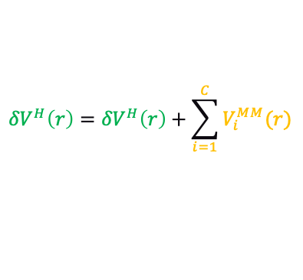
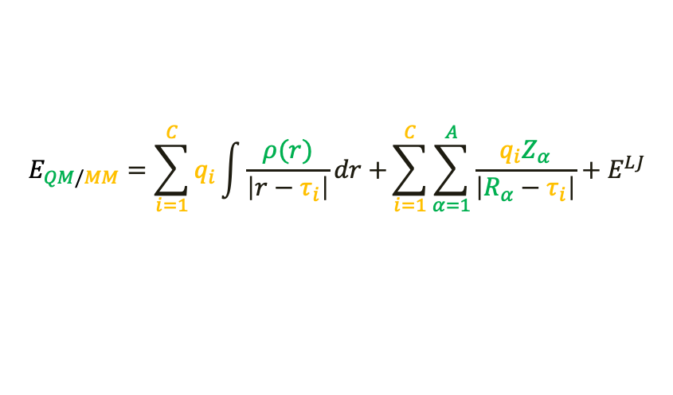
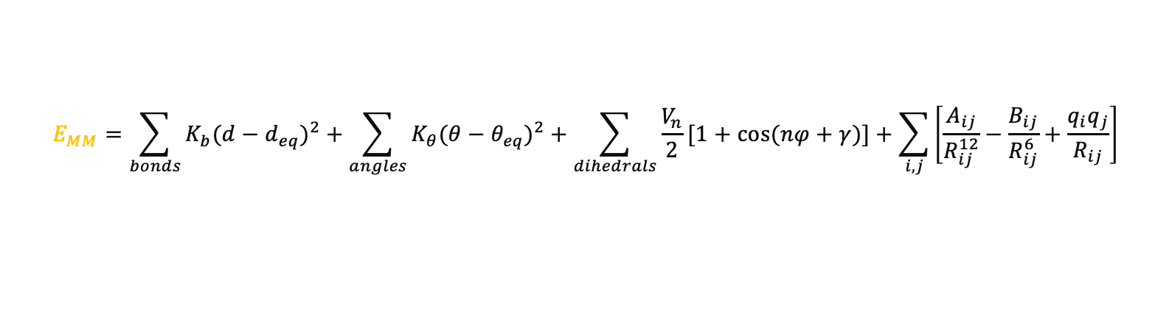
Details about the implementation
The method in SIESTA
QM
MM
Hamiltonian
Total Energy
$$H_{TOT}=H_{QM}+H_{MM}+H_{QM/MM}$$
$$E_{TOT}=E_{KS}+E_{MM}+E_{QM/MM}$$
Classical part energy
$$E_{MM}=\sum_{bonds}{K_{b}{(d−d_{eq})}^{2}}+\sum_{angles}{K_{θ}{(θ−θ_{eq})}^{2}}+\sum_{dihedrals}{\frac{V_{n}}{2}[1+cos(nφ+γ)]}+\sum_{i,j}{\left[\frac{A_{ij}}{R_{ij}^{12}}−\frac{B_{ij}}{R_{ij}^{6}}+\frac{q_{i}q_{j}}{R_{ij}}\right]}$$
Energy of the QM/MM interacting system
Hartree potential
$$E_{QM/MM}=\sum_{i=1}^{C}{q_{i}\int{\frac{ρ(r)}{\left|r−τ_{i}\right|}dr+}}\sum_{i=1}^{C}{\sum_{α=1}^{A}{\frac{q_{i}Z_{α}}{\left|R_{α}−τ_{i}\right|}}+E^{LJ}}$$
$${δV}^{H}\left(r\right)={δV}^{H}\left(r\right)+\sum_{i=1}^{C}{V_{i}^{MM}(r)}$$
Point charge potential
$$V_{i}^{MM}(r)=\frac{q_{i}}{\left|τ_{i}−r\right|}$$
Electrochemical properties using TranSIESTA and QM/MM
Ernane de Freitas Martins
10

Slide 11

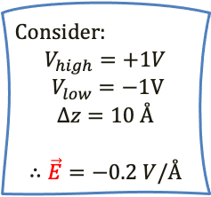



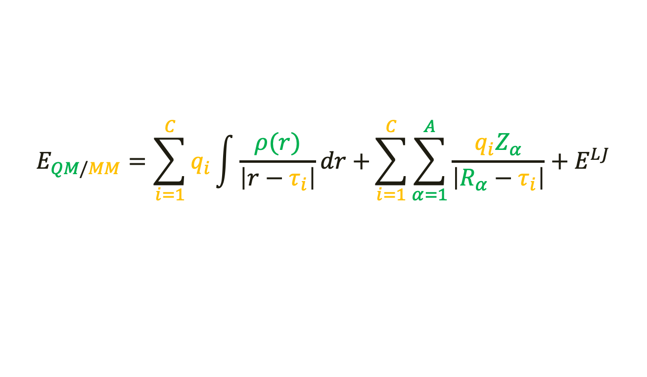
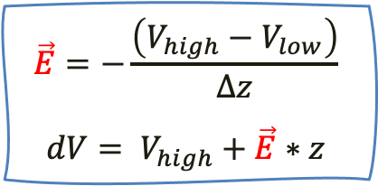
Details about the implementation
Missing term in the energy to couple it with TranSIESTA
QM
MM
$$E_{QM/MM}=\sum_{i=1}^{C}{q_{i}\int{\frac{ρ(r)}{\left|r−τ_{i}\right|}dr+}}\sum_{i=1}^{C}{\sum_{α=1}^{A}{\frac{q_{i}Z_{α}}{\left|R_{α}−τ_{i}\right|}}+E^{LJ}}$$
$$+ \vec{E}$$
1
$${dV}_{z=0}=+1V$$
2
$${dV}_{z=5}=0V$$
Consider:
$$V_{high}=+1V$$
$$V_{low}=−1V$$
$$∆z=10 Å$$
$$∴\vec{E}=−0.2 V/Å$$
dV (V)
Ramp potential
3
$${dV}_{z=10}=−1V$$
$$\vec{E}=−\frac{\left(V_{high}−V_{low}\right)}{∆z}$$
$$dV= V_{high}+\vec{E}∗z$$
z (Å)
Electrochemical properties using TranSIESTA and QM/MM
Ernane de Freitas Martins
11

Slide 12
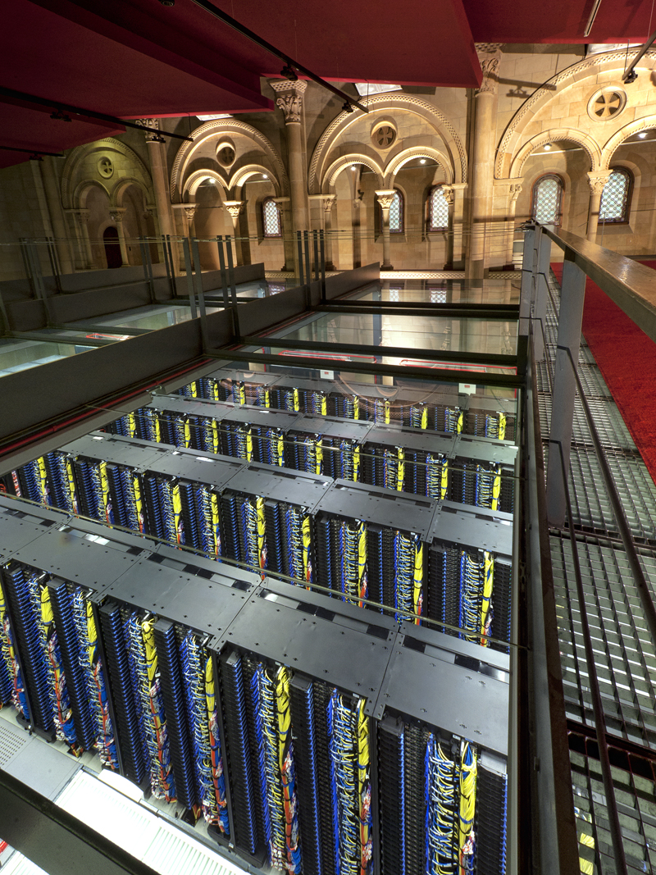

QM
Is the method worthwhile?
MM
performance analysis
QM
MM
Scaling vs. system size: from 236 to 2360 H₂O molecules
Au – (H₂O)_{236 x n} – Au
from n=1 to 10
n = 3
MareNostrum IV @ BSC
Intel Platinum 8160 @ 2.1 GHz
384 cores
96 MPI processes
4 OpenMP threads/MPI process
﻿Ordejón, P.; Martins, E. F.; Febrer, P.; Pedron, F.; Bulletin APS (2023)
Electrochemical properties using TranSIESTA and QM/MM
Ernane de Freitas Martins
12

Slide 13
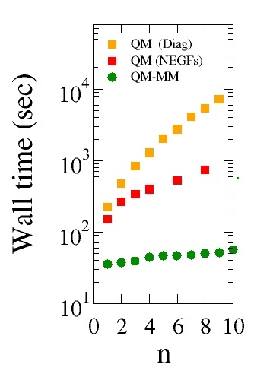
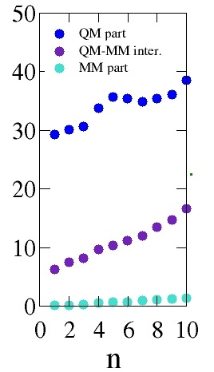
QM
Is the method worthwhile?
MM
performance analysis
QM
MM
Scaling vs. system size: from 236 to 2360 H₂O molecules
x
QM
MM
QM
QM
MM
In 384 cores, for n=1:
QM/MM: 1ps/day
QM (NEGF): 0.1ps/day
Au – (H₂O)_{236 x n} – Au
Wall time for 1 MD step
n / 768 atoms
n / 768 atoms
﻿Ordejón, P.; Martins, E. F.; Febrer, P.; Pedron, F.; Bulletin APS (2023)
Electrochemical properties using TranSIESTA and QM/MM
Ernane de Freitas Martins
13

Slide 14
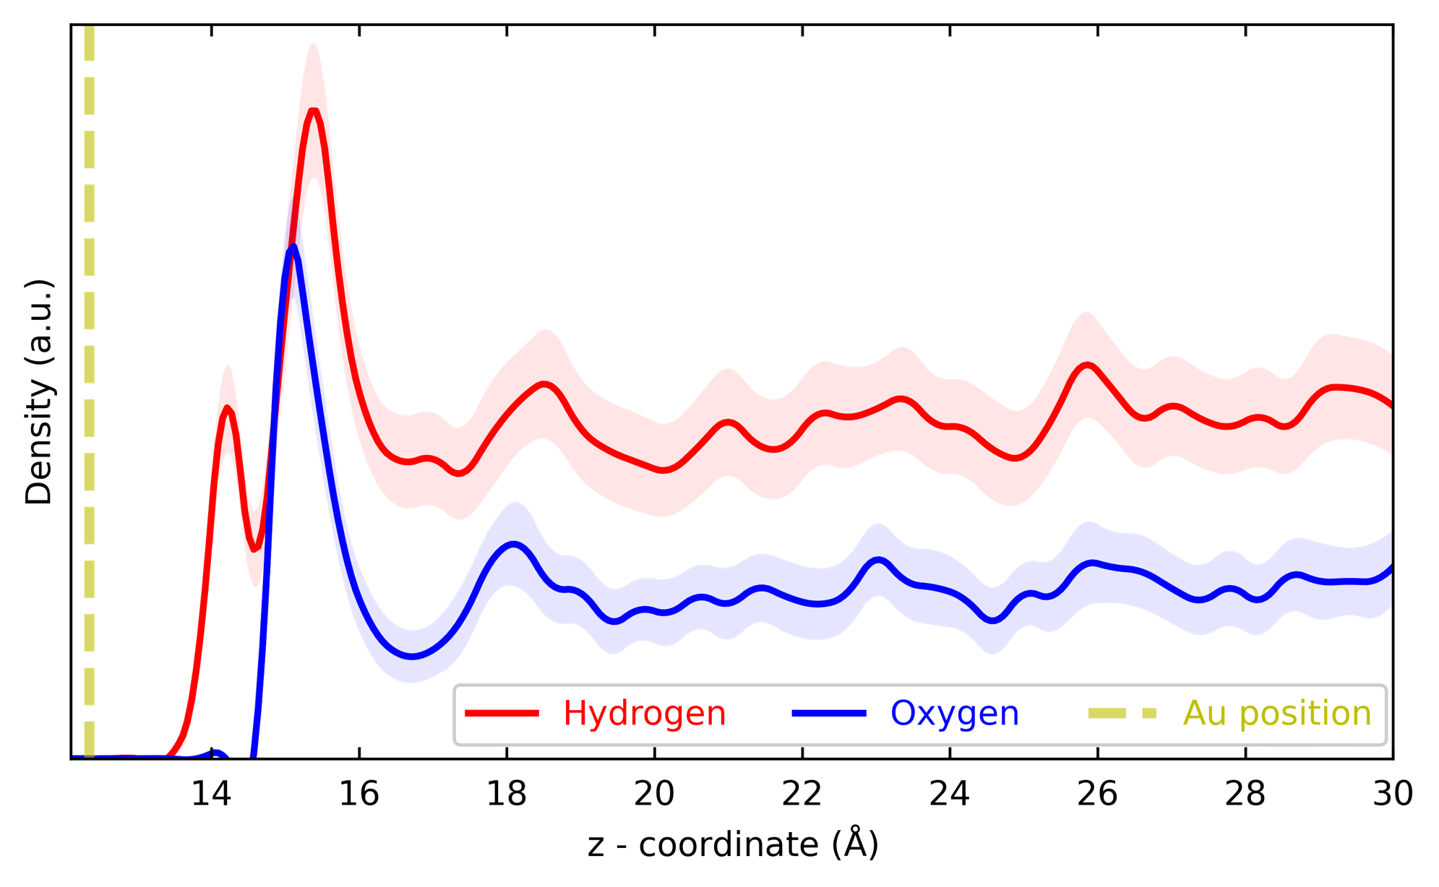
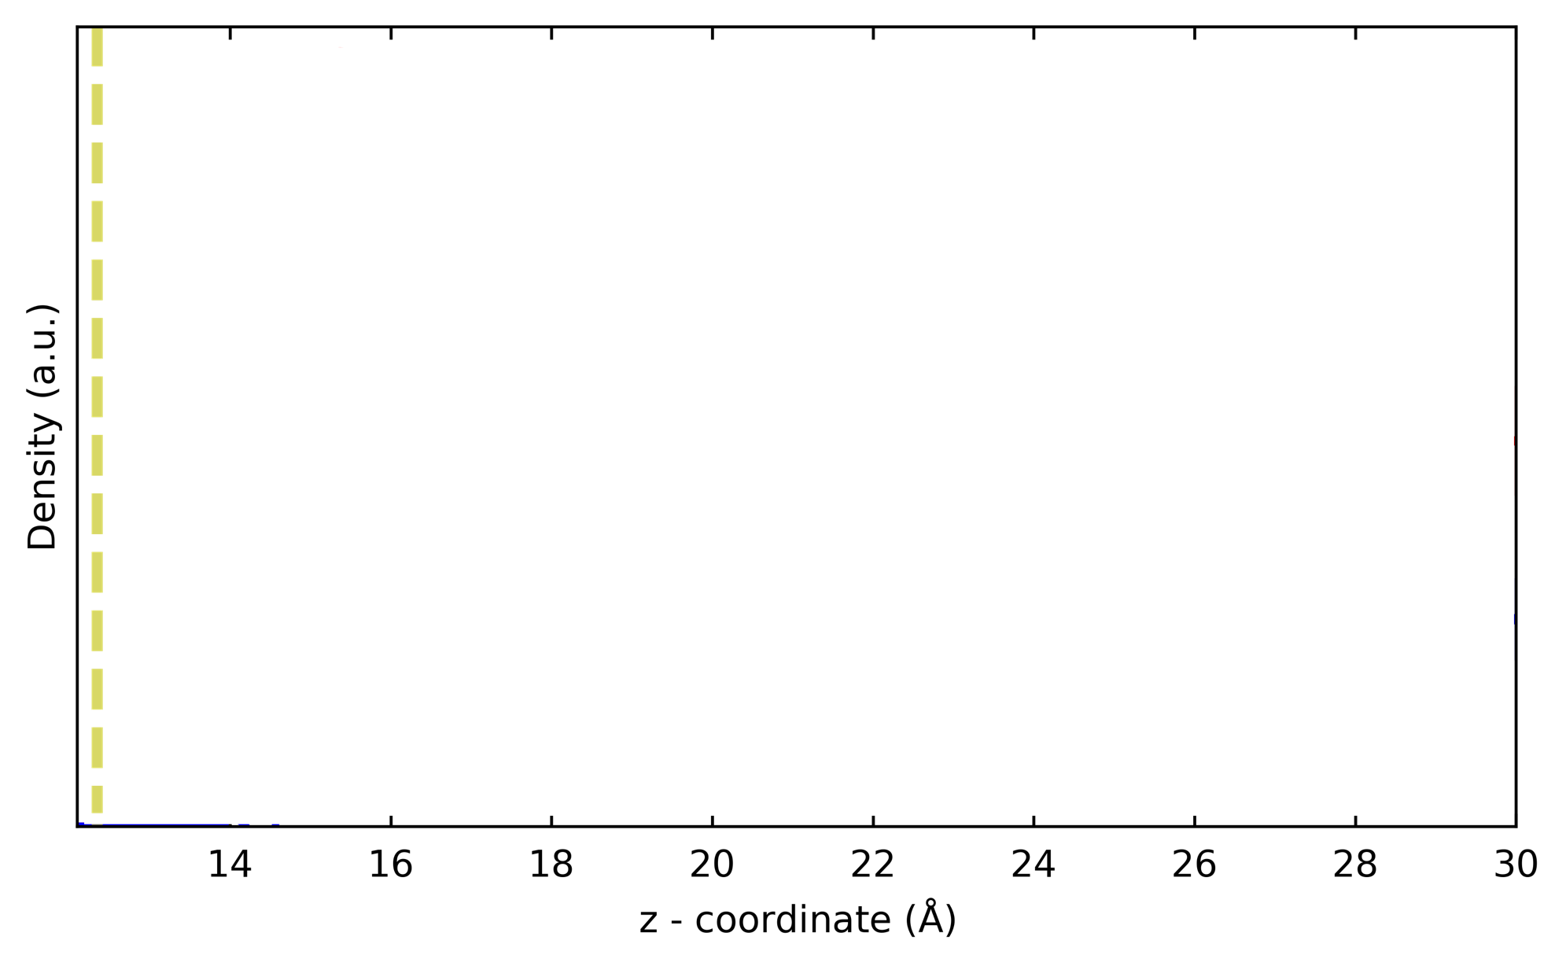
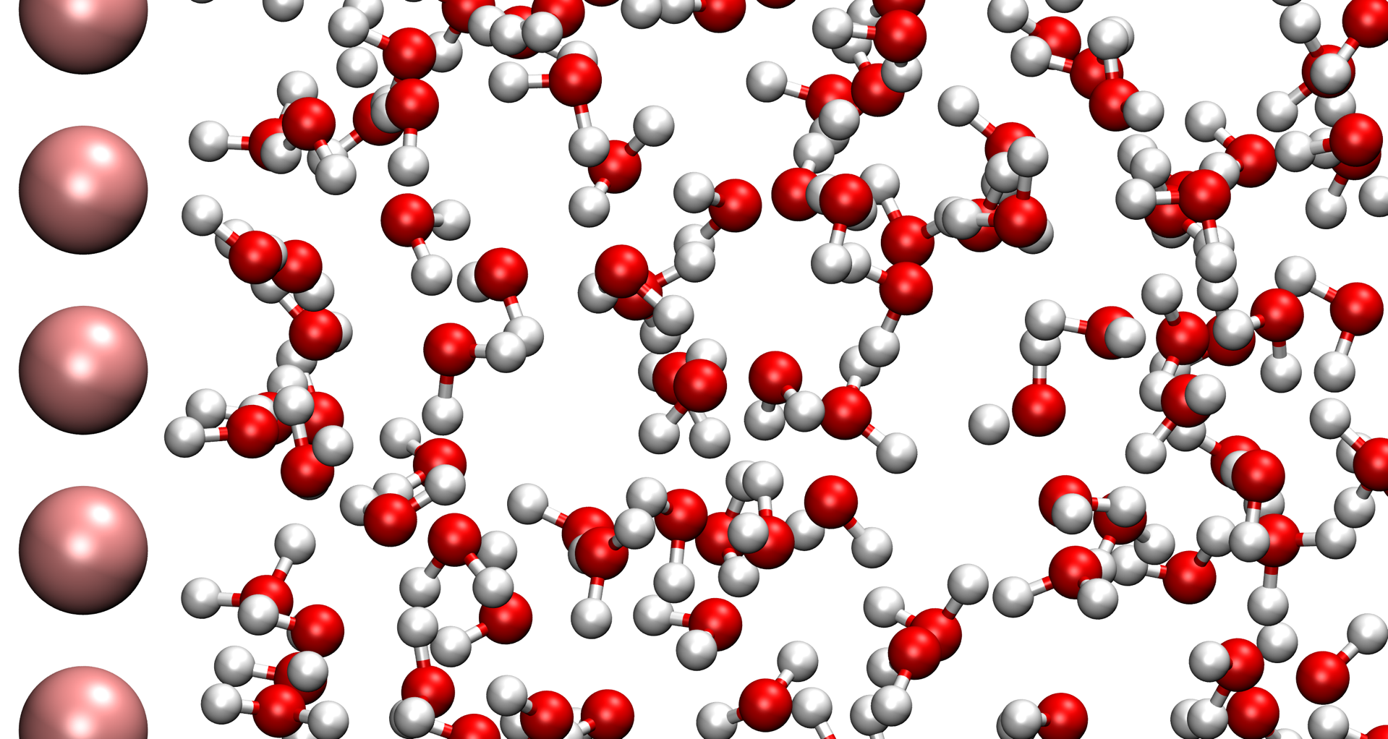
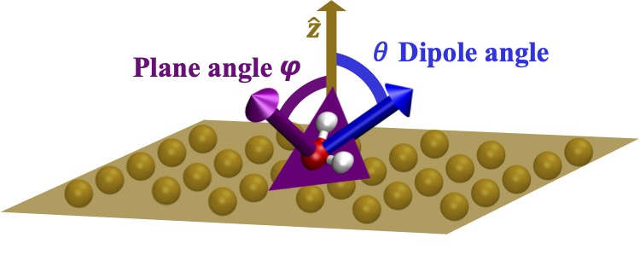
H₂O in contact with electrified gold
QM
MM
calculations
H₂O structuring above electrodes – densities and angles
+1V
﻿Ordejón, P.; Martins, E. F.; Febrer, P.; Pedron, F.; Bulletin APS (2023)
Electrochemical properties using TranSIESTA and QM/MM
Ernane de Freitas Martins
14

Slide 15






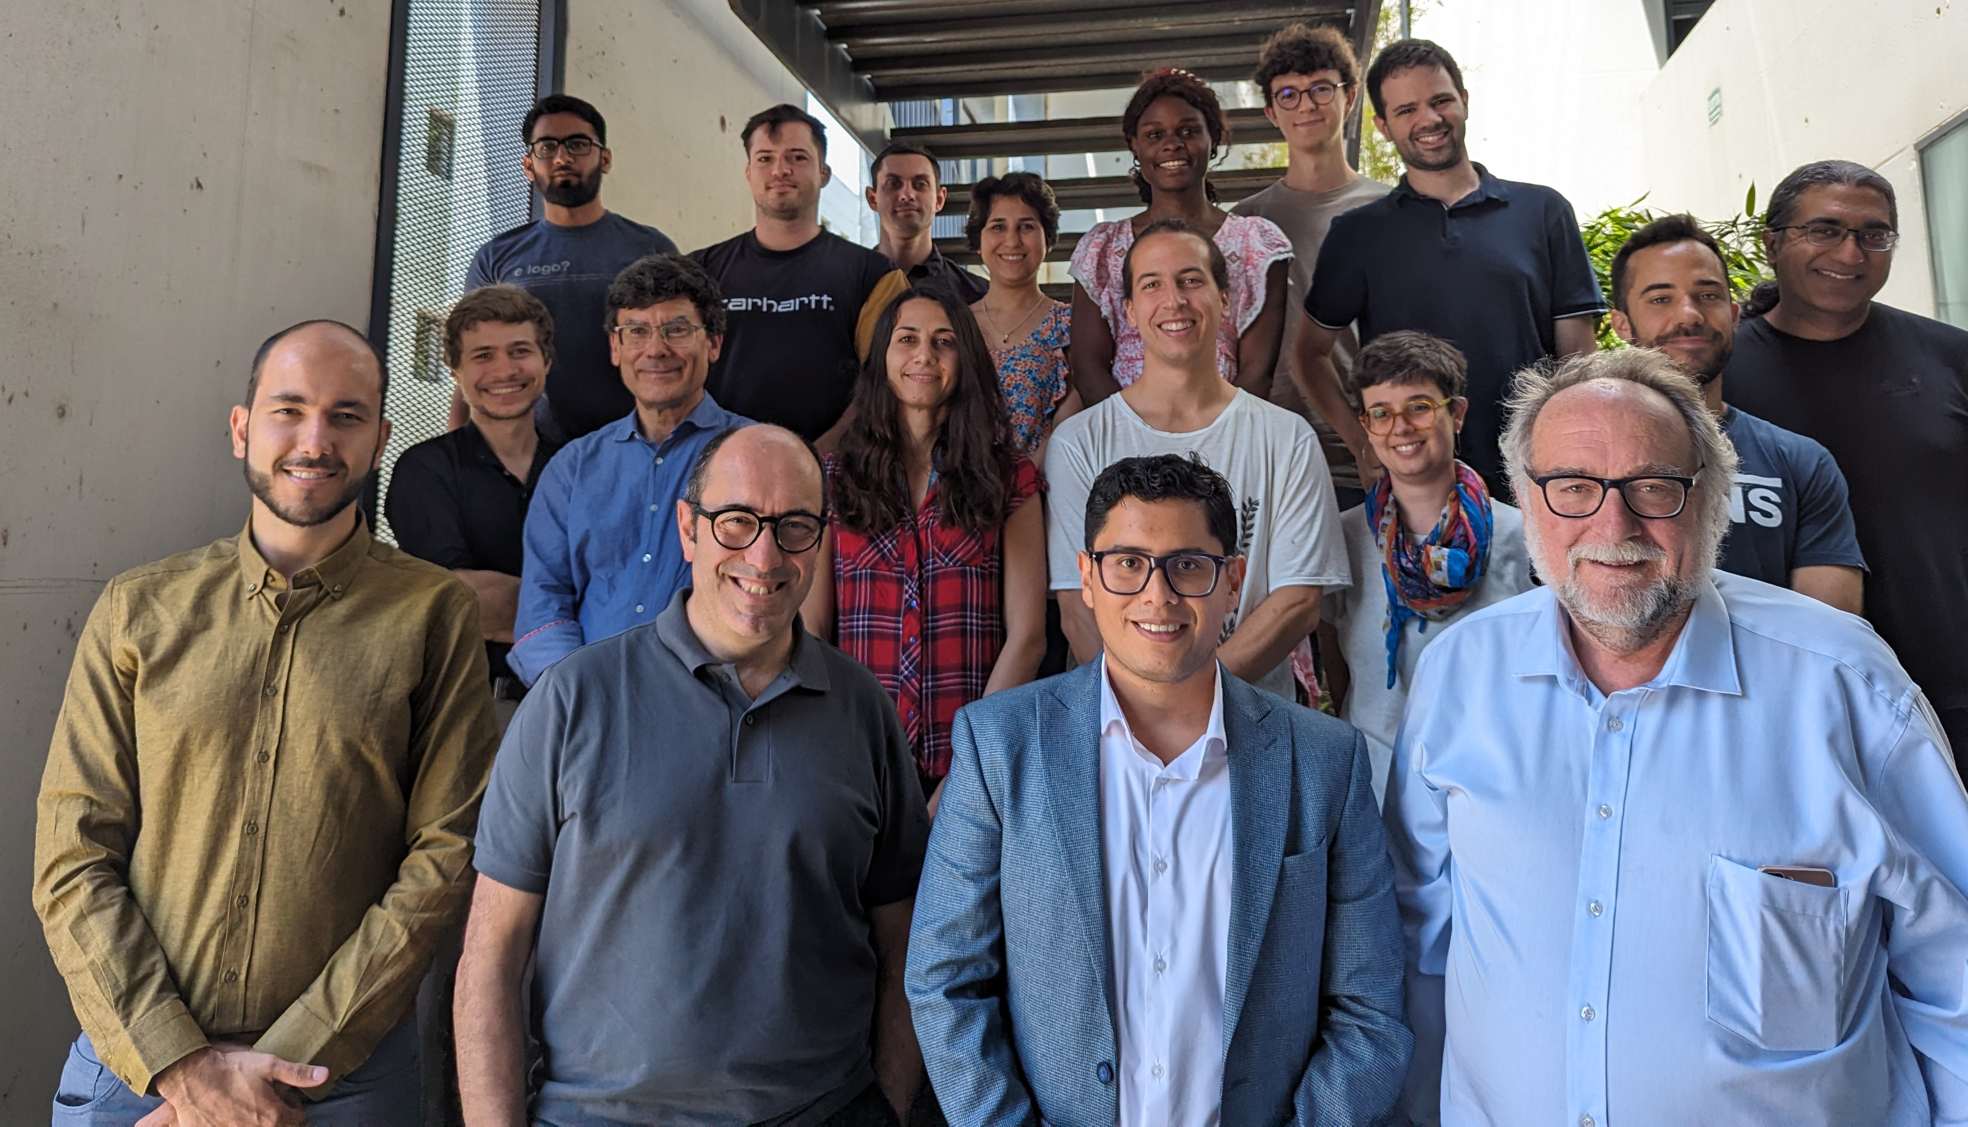





Acknowledgments
Thank you/Obrigado
Gracias
Grant PCI2022-134972-2 funded by MCIN/AEI/ 10.13039/501100011033 and by the European Union NextGenerationEU/PRTR.
Funded by the European Union. This work has received funding from the European High Performance Computing Joint Undertaking (JU) under grant agreement No 101093374 - MaX.
Co-funding from the European Union's Research Fund for Coal and Steel (RFCS) programme under grant agreement No 101112544 (ALCOAT)
Project PID2022‐139776NB‐C62 funded by
MCIN/ AEI /10.13039/501100011033/FEDER
A way of making Europe.
Theory and Simulation group and collaborators
“Funded by the European Union. Views and opinions expressed are however those of the author(s) only and do not necessarily reflect those of the European Union. Neither the European Union nor the granting authority can be held responsible for them.”
Electrochemical properties using TranSIESTA and QM/MM
Ernane de Freitas Martins
15

Slide 16
Time to do the tutorial!
Download the files here:
https://github.com/edefreitas1/Tutorials/raw/refs/heads/main/Electrochemistry_Tutorial.zip
conda install -c conda-forge "siesta=*=*openmpi*"
pip install sisl[viz]
Electrochemical properties using TranSIESTA and QM/MM
Ernane de Freitas Martins
17

Slide 17
Time to do the tutorial!
From scratch:
conda install -c conda-forge "siesta=*=*openmpi*"
conda install sislconda install nodify plotly netCDF4 scikit-image pathos
pip install --upgrade nbformat
conda install matplotlib
export OMP_NUM_THREADS=1
Electrochemical properties using TranSIESTA and QM/MM
Ernane de Freitas Martins
18

